Slide 1
Cg: C for Graphics
Jon Moon
Based on slides by Eugene Lee

Slide 2
Overview
Cg Basics
Vertex Shaders
Fragment Shaders
Using Cg in OpenGL

Slide 3
What is Cg?
Cg is a high level shader language
  Made by NVIDIA, but supports other GPUs
  Programmer writes in a language similar to C
  Cg compiler produces hardware-specific optimized assembly code

Slide 4
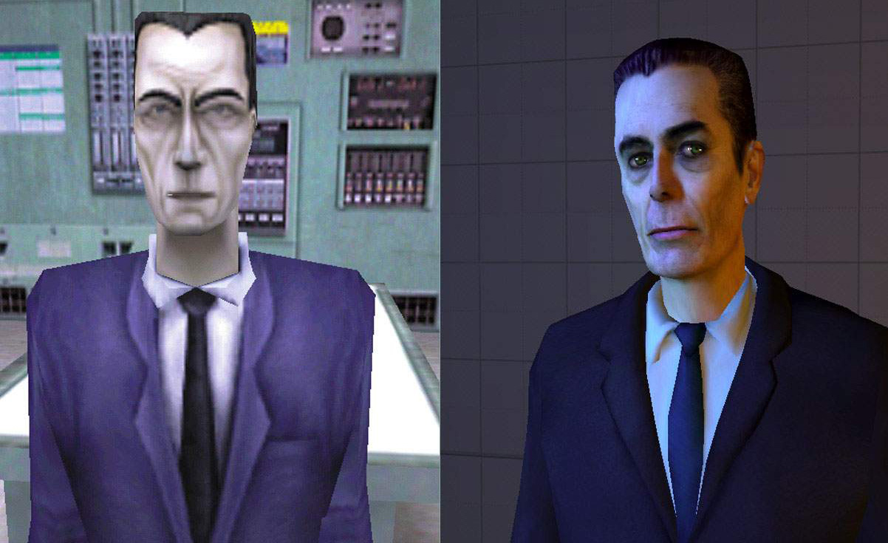
Halflife 1 vs. Halflife 2

Slide 5

http://www.daionet.gr.jp/~masa/rthdribl/index.html

Slide 6
Overview
Motivation
Vertex Shaders
Fragment Shaders
Using Cg in OpenGL
Questions?

Slide 7
The Vertex Shader
Program executed once per vertex
Takes per-vertex input such as position, normal, color, light position, etc.
Determines per-vertex data such as position, color, depth, etc.
  But can do more!
Notes:
VP20… limited to 128 instructions
96 read only vectors and 12 read-write vectors

Slide 8
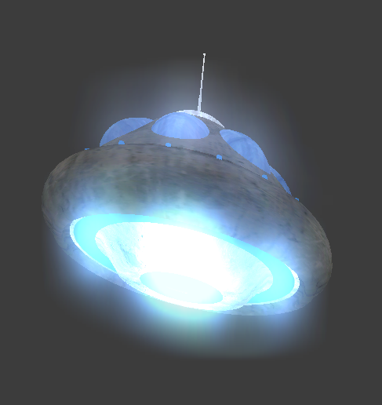
The Vertex Shader

Slide 9
A Vertex Program
struct VertexInput {
float4 position : POSITION;
float3 normal : NORMAL;
}
void NormalShade( VertexInput input,
out float4 outPosition : POSITION,
out float3 outColor : COLOR,
const uniform float4x4 modelViewProjMatrix)
{
outPosition = mul(modelViewProjMatrix, input.position);
outColor = abs(input.normal);
}

Slide 10
Binding Semantics
Predefined “names”
POSITION, NORMAL, etc.
struct VertexInput {
float4 position : POSITION;
float3 normal : NORMAL;
}
void NormalShade(VertexInput input,
out float4 outPosition : POSITION,
out float3 outColor : COLOR,
const uniform float4x4 modelViewProjMatrix) {
outPosition = mul(modelViewProjMatrix, input.position);
outColor = abs(input.normal);
}
Notes:
The input bound to NORMAL corresponds to the value passed into glNormal3f().
Similary, the input/output bound to COLOR corresponds to the value passed into glColor3f().
Information on how to pass information from OpenGL to CG later.
How normal and position are different and are transformed differently too.

Slide 11
Vertex Shader: Input
Varying parameters
  Color, normal, texture coordinates, etc.
  Data specified for each element
glBegin(GL_TRIANGLES);
glColor3f(1.0f, 0.0f, 0.0f);
glNormal3f(0.0f, 1.0f, 0.0f);
glVertex3f(1.0f, 1.0f, 1.0f);
//...
glEnd();
void Shade(float3 color : COLOR,
float3 normal : NORMAL,
float3 position : POSITION,...) {
//...
}
OpenGL
CG Vertex Program

Slide 12
Vertex Shader: Input
Uniform Parameters
  Data that remains constant over each element
  Parameter shadowing
cgSetParameter3f(kdParam, 0.3f, 0.2f, 0.6f)
glBegin(GL_TRIANGLES);
//...
glEnd();
void Shade(..., const uniform float3 kd) {
//...
}
OpenGL
CG Vertex Program

Slide 13
Vertex Shader: Output
Output serves as varying input to fragments
“Custom data” usually output as texcoords
struct VertexInput {
float4 position : POSITION;
float3 normal : NORMAL;
}
void NormalShade(VertexInput input,
out float4 outPosition : POSITION,
out float3 outColor : COLOR,
const uniform float4x4 modelViewProjMatrix) {
outPosition = mul(modelViewProjMatrix, input.position);
outColor = abs(input.normal);
}

Slide 14
Types in Cg
Syntax similar to C
Basic types
  int, float, half, fixed, bool
Vector/Matrix types
  int4, float3, bool2, float4x4
Arrays
  int a[3], float4x4 matrices[4][4]
Notes:
Give usage examples on board.
float3 vec = float3(1, 1, 0);
float3 position = mul(modelViewProjMatrix, input.position).xyz;
float4x4 matrix;
matrix.m_33;
Swizzling

Slide 15
Playing with types
Vector initialization and swizzling
  float4 vec4 = float4(1, 1, 1, 0);
  float3 vec3 = vec4.yzw;
  float3 color = vec3.rgb;
  float3 position = 1.xxx;

Slide 16
Overview
Motivation
Vertex Shaders
Fragment Shaders
Using Cg in OpenGL
Questions?

Slide 17
The Fragment Shader
Program executed once per rasterized pixel.
Takes varying output from vertex program.
  Certain outputs, like TEXCOORD0 interpolated.
Determines final color, depth for pixel.

Slide 18
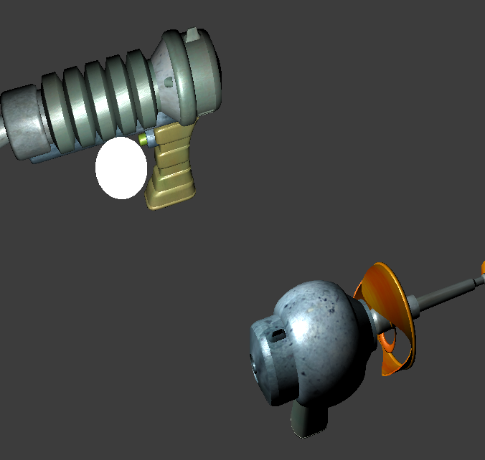
The Fragment Shader

Slide 19
A Fragment Program
float3 SinWave(float3 tex : TEXCOORD0) : COLOR {
return sin(tex.x);
}
Notes:
Can return color output (different from previous vertex program).
The program procedurally generates a sin wave w.r.t. x.

Slide 20
A Fragment Program
void PerPixelLight(float3 position : TEXCOORD0,
float3 normal : TEXCOORD1,
const uniform float3 eye,
const uniform float3 light) {
float3 L = normalize(light – position);
float3 V = normalize(eye – position);
outColor = computeRd(L, N) + computeRs(L, V, N);
}
Notes:
Position and normal values interpolated from vertices…
Can capture specular highlight within triangle this way…

Slide 21
Performance
Fragment Programs are Expensive!
  Try to do as much as possible in vertex programs.
  Try to keep fragment programs small.
Note: not all hardware supports fragments
  Rhodes 453 has Quadro FX GPU’s, which DO support fragment programs
Notes:
Register combiners – fp20 profile.
texutre + arithmetic operations. 4 texture instructions + 8 arithmetic instructions

Slide 22
Overview
Motivation
Vertex Shaders
Fragment Shaders
Using Cg in OpenGL
Questions?

Slide 23
Initializing Cg
Create a context
  CGcontext cgContext = CgGL.cgCreateContext();
Select and enable Profile
  int cgVertexProfile = CgGL.CG_PROFILE_VP20;
  CgGL.cgGLEnableProfile(cgVertexProfile);
Create & Load program
  CGprogram cgVertexProgram = CgGL.cgCreateProgramFromFile(cgContext, CgGL.CG_SOURCE, "Normal.cg", cgVertexProfile, "Normal", null);
  CgGL.cgGLLoadProgram(cgVertexProgram1);

Slide 24
Executing Cg
Get handles for parameters
  CGparameter mvpMatrix = CgGL.cgGetNamedParameter(cgVertexProgram, “ModelViewProjMatrix”);
Set parameters
  CgGL.cgGLSetStateMatrixParameter( mvpMatrix, CgGL.CG_GL_MODELVIEW_PROJECTION_MATRIX, CgGL.CG_GL_MATRIX_IDENTITY)
Bind program
  CgGL.CgGLBindProgram(cgVertexProgram);
Rendering
  glBegin()…
Notes:
Do simple complete example on board if time permits

Slide 25
Cg in Action: Normal Shader
First demo: using 1 vertex shader to shade a cube based on its normal
Based on OpenGLDemo02 from last week
First look at Normal.cg, then at the Java code to actually use it

Slide 26
Normal.cg
struct VertexInput {
float4 position : POSITION;
float3 normal : NORMAL;
};
struct VertexOutput {
float4 position : POSITION;
float3 color : COLOR0;
};
VertexOutput Normal(const VertexInput input,
const uniform float4x4 ModelViewProjMatrix) {
VertexOutput output;
output.position = mul(ModelViewProjMatrix, input.position);
output.color = (input.normal+1)/2;
return output;
}

Slide 27
Vertex.java: declarations
protected CGcontext cgContext;
protected int cgVertexProfile;
protected static CGprogram cgVertexProgram;
protected static CGparameter cgModelViewProjMatrix;

Slide 28
Vertex.java: initializations
cgContext = CgGL.cgCreateContext();
cgVertexProfile = CgGL.CG_PROFILE_VP20;
CgGL.cgGLEnableProfile( cgVertexProfile);
cgVertexProgram = CgGL.cgCreateProgramFromFile( cgContext, CgGL.CG_SOURCE, "Normal.cg", cgVertexProfile, "Normal", null);
CgGL.cgGLLoadProgram(cgVertexProgram);
cgModelViewProjMatrix = CgGL.cgGetNamedParameter( cgVertexProgram, "ModelViewProjMatrix");

Slide 29
Vertex.java: Display loop
CgGL.cgGLBindProgram(cgVertexProgram);
CgGL.cgGLSetStateMatrixParameter( cgModelViewProjMatrix, CgGL.CG_GL_MODELVIEW_PROJECTION_MATRIX, CgGL.CG_GL_MATRIX_IDENTITY);

Slide 30
More than 1 Vertex Program
Can use different vertex (fragment) programs for different geometry!
Initialize programs as you would normally
  1 context, 1 vertex profile, many programs, many loads, etc.
In display loop, bind appropriate VP before gl_Begin() … gl_End().
To use another VP, simply bind to it before the next gl_Begin() … gl_End().

Slide 31
TwoVertex.java
Code very similar to Vertex.java
We load the pastel normal shader for the front and back faces, then load the bright normal shader for the rest of the cube
Note that we needed to gl_End() after the first 2 faces, then bind our next VP, then gl_Begin(GL_QUADS) again

Slide 32
SinWave.cg
float3 SinWave(float3 tex : TEXCOORD0) : COLOR {
return (sin(sin(23*tex.x*tex.y)-10*tex.y)+1)/2;
}
This shader is just using the texture coordinates, and some math.
Like position and normal, these are made available by OpenGL automatically
  But if SinWave needed other parameters, we would obtain and modify them as usual.

Slide 33
Fragment.java: declaration, init
Very similar to Vertex, except with all “vertex”es replaced with “fragment”s
We make sure to specify the texture coordinates for the corners of each face
  Texture coords are interpolated across polygons, so fragment programs can use them readily

Slide 34
Lambertian, a la PA1
Vertex program finds the normal and light vectors in world space, outputting those as COLOR0, COLOR1
Fragment program gets interpolated normal, light vector for each pixel and calculates lighting

Slide 35
Lambertian.java
Does standard declare, init:
  1 context, 2 profiles (create, enable), 2 programs (create, load)
  Gets, sets all necessary variables for both programs
  In display loop, bind both VP and FP
  That’s it!

Slide 36
Some Tips
Check for errors!
  CgErrorException.checkCgError();
  Debug output in shaders
  Normals, incident directions, different terms in BRDFs, etc.
Can compile .cg programs
  cgc –profile vp20 –entry (function name) Program.cg

Slide 37
PA1: Cg Shaders portion
Write a couple of shading models
Must set the input parameters to cg programs.
Reference Lambertian shader code provided

Slide 38
Resources
NVIDIA Cg:
  http://developer.nvidia.com/page/cg_main.html
Cg User Manual:
  http://developer.nvidia.com/object/cg_users_manual.html
  Also in Cg Toolkit folder
http://www.cgshaders.org

